Slide 1
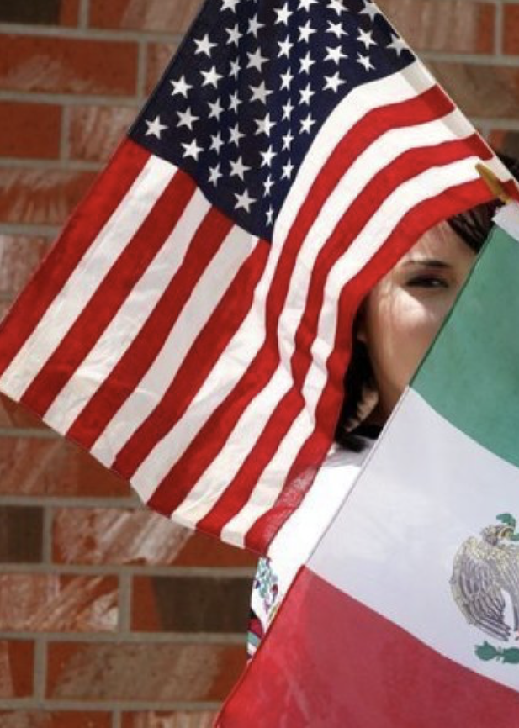
Give Me Your Poor, Your Tired, Your Homeless (Some Restrictions
May Apply):
Immigration to the United States in the 21st Century
Bob Gitter, Ohio Wesleyan
Prof of Econ, Emeritus
National Economic Education Delegation
University of Connecticut OLLI
Storrs, CT
April 24, 2025

Slide 2
National Economic Education Delegation
Vision
  One day, the public discussion of policy issues will be grounded in an accurate perception of the underlying economic principles and data.
Mission
  NEED unites the skills and knowledge of a vast network of professional economists to promote understanding of the economics of policy issues in the United States.
NEED Presentations
  Are nonpartisan and intended to reflect the consensus of the economics profession.

Slide 3
Who Are We?
Honorary Board: 54 members
  2 Fed Chairs: Janet Yellen, Ben Bernanke
  6 Chairs Council of Economic Advisers
    Furman (D), Rosen (R), Bernanke (R), Yellen (D), Tyson (D), Goolsbee (D)
  3 Nobel Prize Winners
    Akerlof, Smith, Maskin
Delegates: 652+ members
  At all levels of academia and some in government service
  All have a Ph.D. in economics
  Crowdsource slide decks
  Give presentations
Global Partners: 48 Ph.D. Economists
  Aid in slide deck development

Slide 4
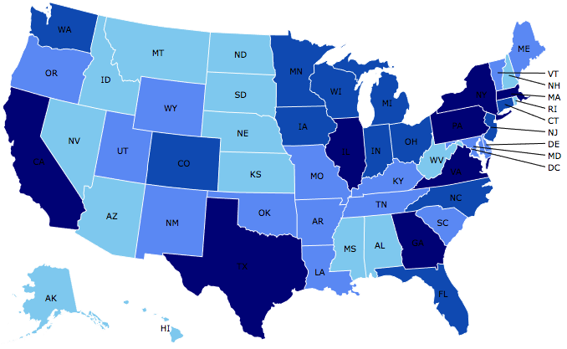
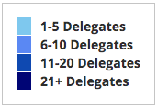
Where Are We?

Slide 5
SubSubmitting Questions
Hopefully there will be time for a a Q&A after the presentation
Please submit questions in chat or you can email them to me later at rjgitter@owu.edu I will try to answer by email

Slide 6
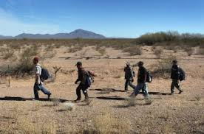
Migration to the US
Difficult to Measure How Many
Legal Immigrants - easy
Undocumented Immigrants
Return Immigrants – no record if return

Slide 7
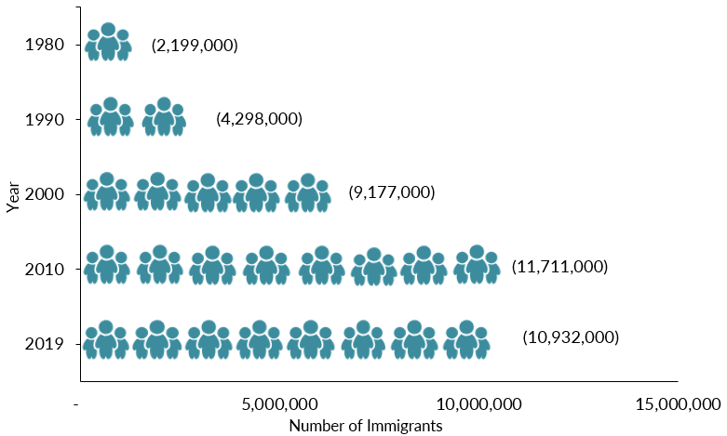
Mexican-Born People in the US
About 10.6 million in 2022 (Latest data)
1 in 14 people born in Mexico currently lives in the US

Slide 8
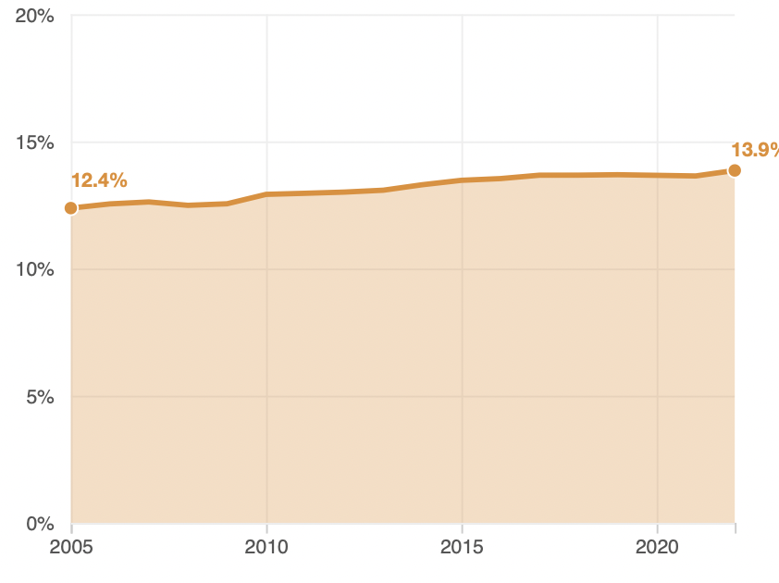
Immigrant Share of US Population
14.3 %
12.4 %

Slide 9
Immigrant Share of US Population
Connecticut 16.3%
Storrs 14.5 %
12.4 %
14.3 %

Slide 10
The Migration Decision
Benefit of Migrating
Benefit of Staying
Cost of Migrating

Slide 11
Distribution of Income
Mexico
United States
Number of People
Income

Slide 12
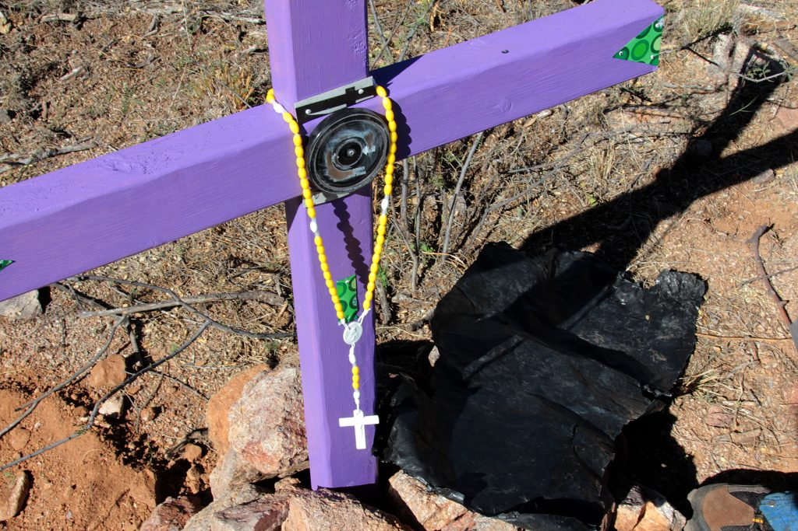
The Dangers of Border Crossing

Slide 13
Key Laws
Quota and Immigrations Acts (1921 and 1924)
Bracero Program(1942-1964)
Immigration and Nationality Act (1965)
Immigration and Control Act (1986)

Slide 14
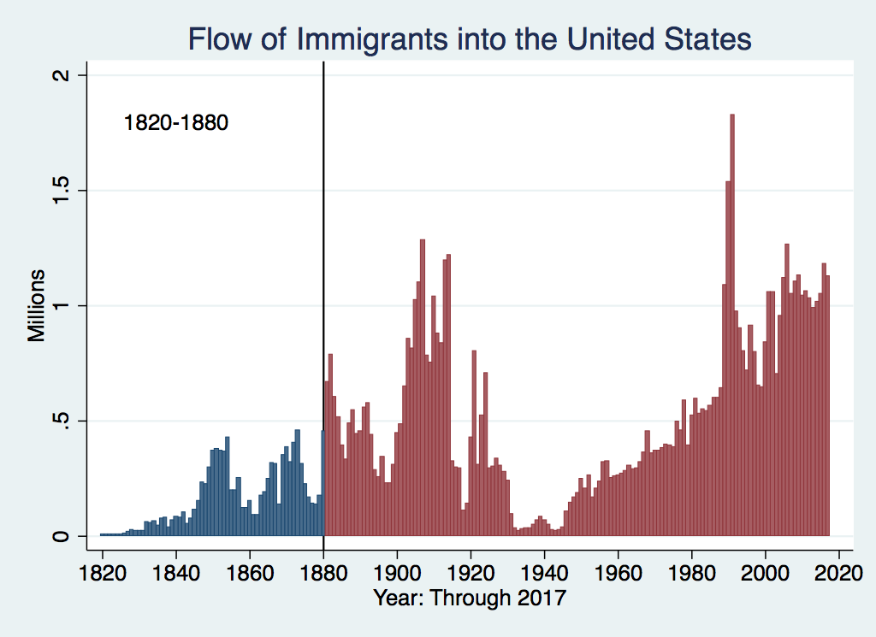
U.S. Immigration 1820-1880
Source Country | 1820-1880
Germany | 3,000,000
Ireland | 2,800,000
Britain | 2,000,000
Austro-Hungarian Empire | 1,000,000
Canada | 750,000
China | 230,000
Africa | 50,000
https://www.libertyellisfoundation.org/immigration-timeline

Slide 15
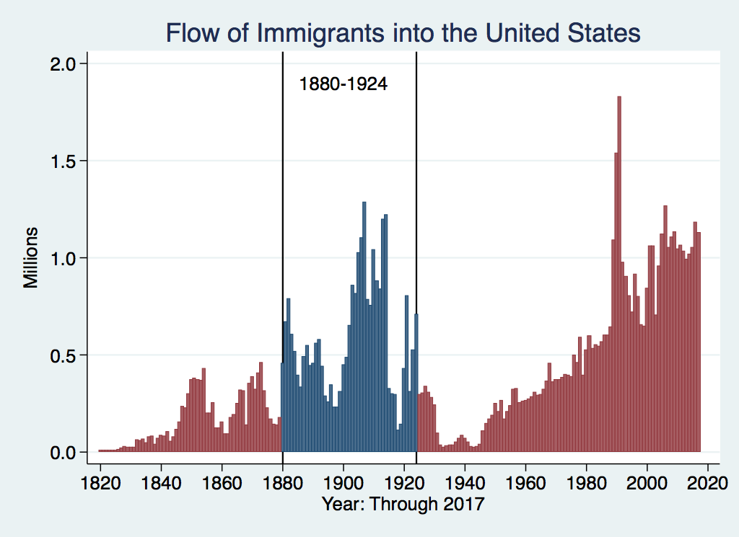
U.S. Immigration 1880-1924
Source Country | 1880-1930
Italy | 4,600,000
Austro-Hungarian Empire | 4,000,000
Russian Empire | 3,300,000
German Empire | 2,800,000
Britain | 2,300,000
Canada | 2,300,000
Ireland | 1,700,000

Slide 16
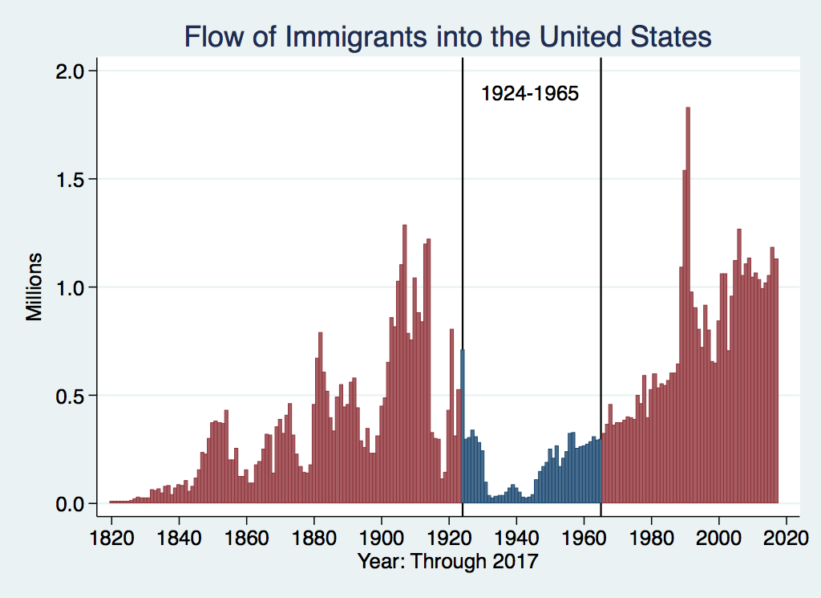
U.S. Immigration 1924-1965
Source Country | 1930-1965
Germany | 940,000
Canada | 900,000
Mexico | 610,000
Britain | 480,000
Italy | 390,000
Caribbean/ West Indies | 310,000
https://www.libertyellisfoundation.org/immigration-timeline

Slide 17
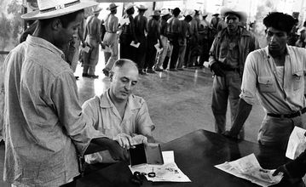
Signing up for Bracero Program

Slide 18
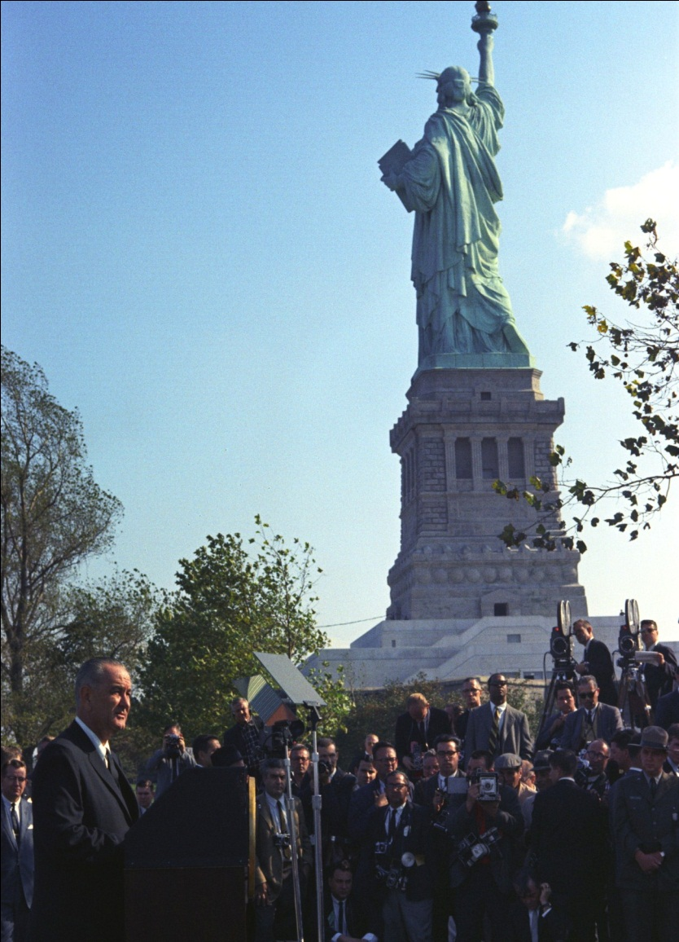
LBJ Signs Immigration and Nationality Act (1965)
Abolished Quotas
Limits immigration to about 1 million/year
Family reunification most important consideration

Slide 19
NUMBER OF IMMIGRANTS BY TYPE OF ADMISSION: FISCAL YEAR 2022
Family-sponsored preferences | 165,642
Immediate relatives of U.S. citizens | 428,581
Employment-based preferences³ | 270,206
Diversity | 43,175
Refugees | 29,407
Asylees | 53,662
Other | 27,331
TOTAL | 1,018,004
{
594,223

Slide 20
H1B Applications
Quota Reached on First Day 2017

Slide 21
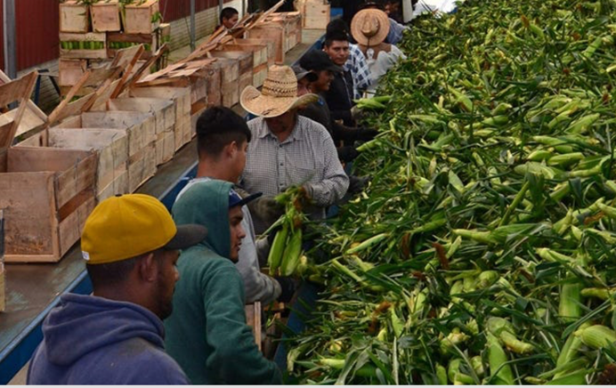
H2A Program

Slide 22
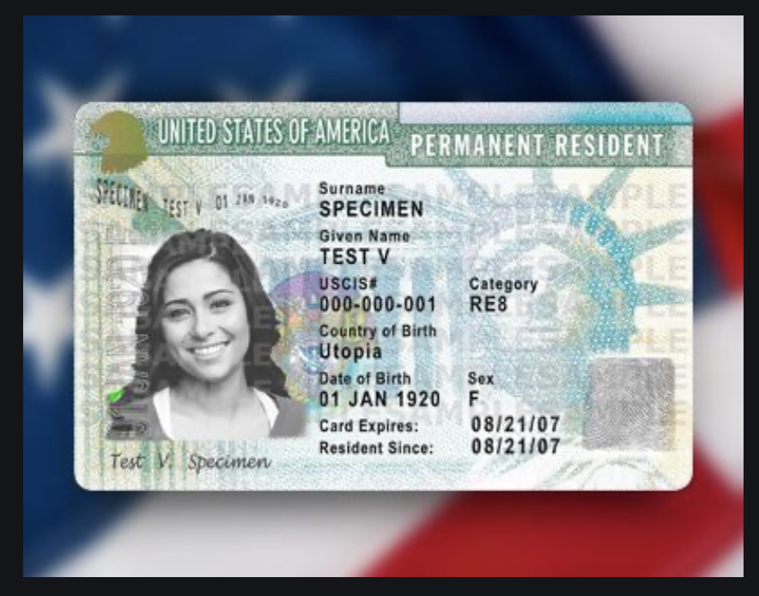
Immigration Reform and Control
Act of 1986
Grants amnesty to undocumented individuals in US since 1982
Must pay penalty and back taxes
Amnesty granted for being undocumented
Path to citizenship
Two million people took advantage, mostly Mexican
Illegal to knowingly hire undocumented workers
Green Card

Slide 23
Immigrant Share of US Workforce
2024 19.1 % immigrant share

Slide 24
Origin of Immigrants
Home | U.S. Share | CT Share
Africa | 5.8 % | 4.4 %
Asia | 30.5 % | 22.9 %
Europe | 10.1 % | 19.0 %
Lat. Amer | 51.2 % | 51.0%
N. America | 1.7 % | 2.4 %
Oceana | 0.6 % | 0.3 %
Total | 100.0 % | 100.0 %
https://www.migrationpolicy.org/data/state-profiles/state/demographics/US/CT/

Slide 25
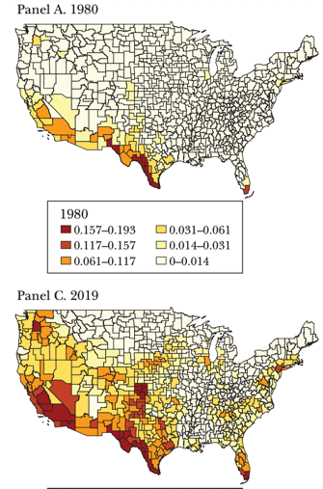
Share of Population Born in Latin America & Caribbean
1980
2019

Slide 26
Immigration to Connecticut
Immigrants tend to be of working age. Moreso than the U.S. Born
Age | Foreign Born | United States Born
0-15 | 5.7 % | 19.6 %
16-64 | 76.5% | 61.6 %
65+ | 17.7% | 19.3 %

Slide 27
Immigration to Connecticut
Country of Origin | Percent of Immigrants
Jamaica | 7.9 %
Ecuador | 7.1 %
India | 6.2 %
Dominican Republic | 5.5%
Brazil | 5.2 %

Slide 28
Immigration to Connecticut
Education Level | Foreign Born Population | U.S. Born Population
Less than High School | 18.4 % | 5.8 %
High School & Some College | 44.3% | 49.8 %
Bachelor’s Degree | 18.7 % | 24.3 %
Graduate Degree | 18.7 % | 20.1 %

Slide 29
Immigration to Connecticut
Top Occupations with Highest Share of Immigrant Workers
Occupation | Share of Workers Immigrants
Maids & Housekeepers | 69.4 %
Nursing Assistants | 41.6 %
Personal Care Assistants | 35.2 %
Postsecondary Teachers | 34.7 %
Janitors | 30.1 %
 | 11.0 %
 | 7.7 %
Chin | 5.1 %
Philippines | 3.1 %
Canada | 2.5 %

Slide 30
Characteristics of Native and Latin Amer. Born Population (Age 16 & up)
 | Native Born | Lat. Amer. Born
Labor Force | 130 Mil. | 13 Mil
< H.S. Educ | 5.8% | 37.1.%
Poor English | 1.9% | 77%
Employed | 59.2% | 64.9%
Unemployed | 3.0% | 3.5%
Med. Wk. Earn | $1,087 | $758
Poverty Rate | 13% | 17%

Slide 31
Impact of Latin American Immigration
Low-skill, low-wage jobs.
Competition for less skilled native-born
More GDP & lower prices
Helps upper income native-born, hurts lower
Little impact on federal budget but raises costs for state and local (schooling)

Slide 32
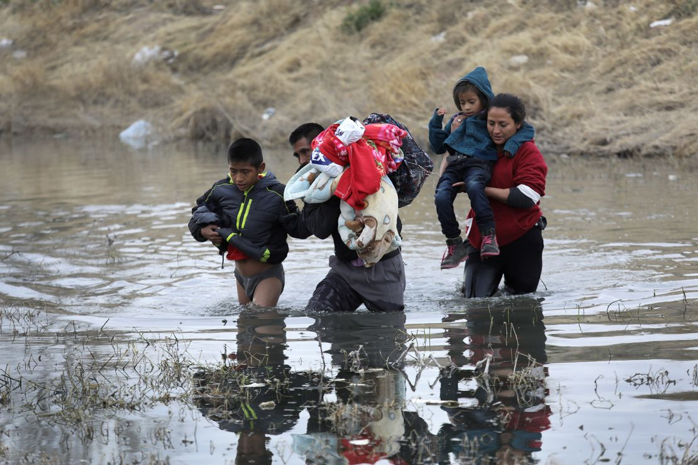
Recent Immigration Issues
DACA
The Northern Triangle
Remain in Mexico
Unaccompanied Minors
The Venezuelan Wave
Haitians in Springfield, Ohio
Recent Exec. Orders

Slide 33
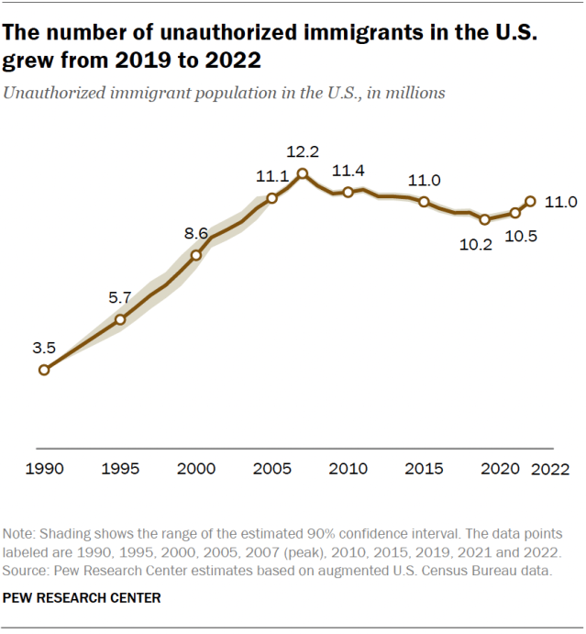
Undocumented Immigrants in the U S
Connecticut has about 116,000 undocumented immigrants. About 19.9 % of Foreign Born Population
Source: PEW Foundation.

Slide 34
DACA (Deferred Action for
Childhood Arrivals)
Entered U.S. before age 16, now in U.S.
Entered before June 2007
Currently in school, high school grad or honorable discharge from military
No felony conviction or threat to security
Renewable every 2 years
Executive Order by Obama, Trump ended, Biden restored
2,930 in Connecticut

Slide 35
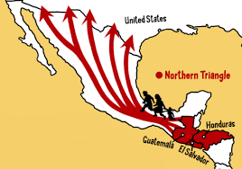
The Northern Triangle

Slide 36
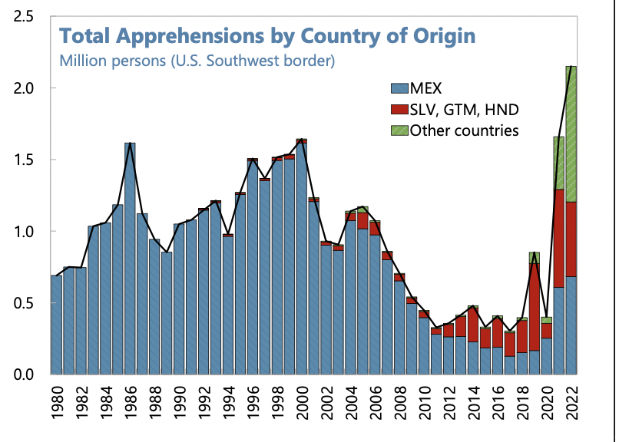
Northern Triangle Apprehensions
(Northern Triangle Countries in Red)

Slide 37
Estimated Unauthorized Immigrant Population
 | 2022 | 2012 | 2000
Total | 11,000,000 | 11,200,000 | 8,600,000
Mexico | 4,050,000 | 5,850,000 | 4,450,000
El Salvador | 750,000 | 675,000 | 500,000
India | 725,000 | 450,000 | 240,000
Guatemala | 675,000 | 525,000 | 200,000
Honduras | 525,000 | 350,000 | 140,000
China | 375,000 | 325,000 | 325,000
Venezuela | 275,000 | 70,000 | 45,000
Brazil | 230,000 | 100,000 | 90,000
Dominican Republic | 230,000 | 170,000 | 180,000
Colombia | 190,000 | 160,000 | 150,000

Slide 38
Asylees and Refugees
Refugees are usually outside the United States when they are screened for resettlement in US
Asylum seekers submit their applications while physically present in the United States or at a U.S. port of entry
Reason to grant – (US & UNCOR) unable to return because of persecution or a well-founded fear of persecution based on: race, religion, nationality, membership in a particular social group, or political opinion. (Not economic hardship!)

Slide 39
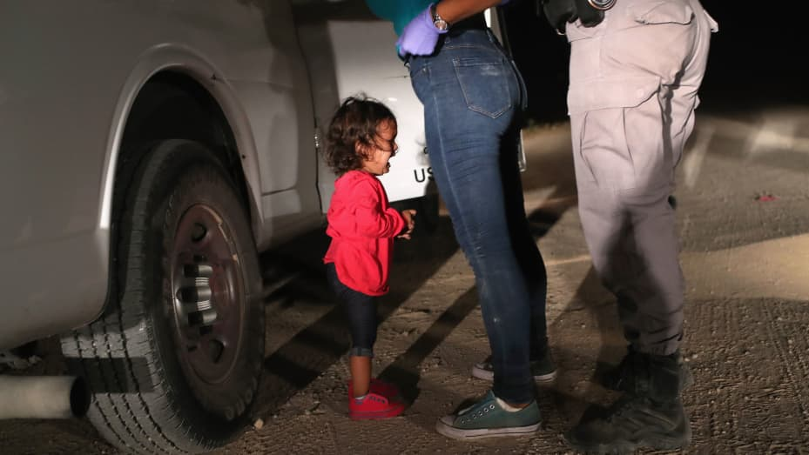
Separation of Children

Slide 40
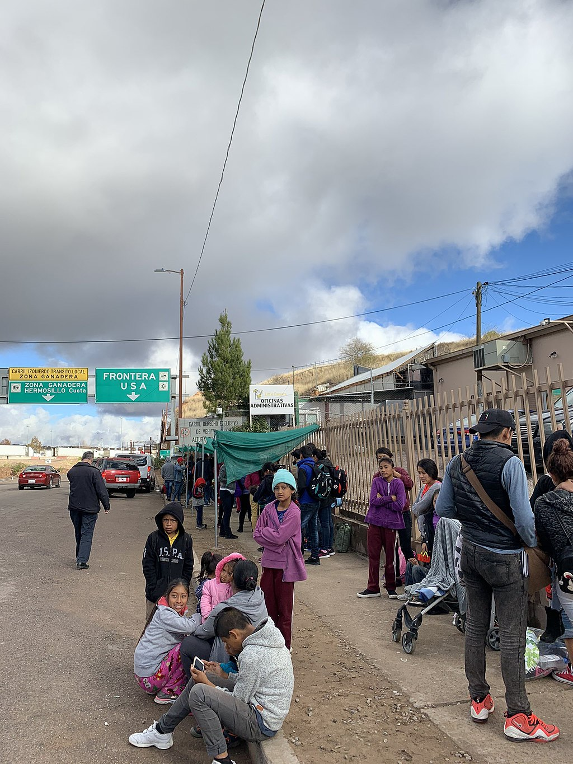
Remain in Mexico Policy
Started 2019. Applies to non-Mexicans asking for asylum
Must wait in Mexico while case being heard
Not applied to unaccompanied minors
Not eligible for asylum if passed through another nation on way.
Dangerous in Mexico
Ended in 2022 but the termination was successfullychallenged in the courts
President Trump reinstated last month

Slide 41
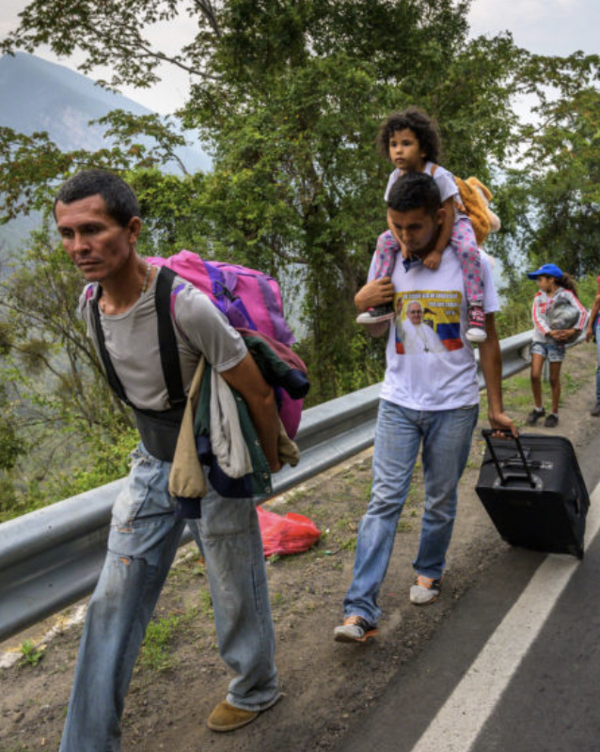
The Surge of Venezuelans
Almost 8 million Venezuelans have left
Caused by economic mismanagement, hyperinflation, unrest, violence
Largest national group arrested for entering US
Temporary Protected Status

Slide 42
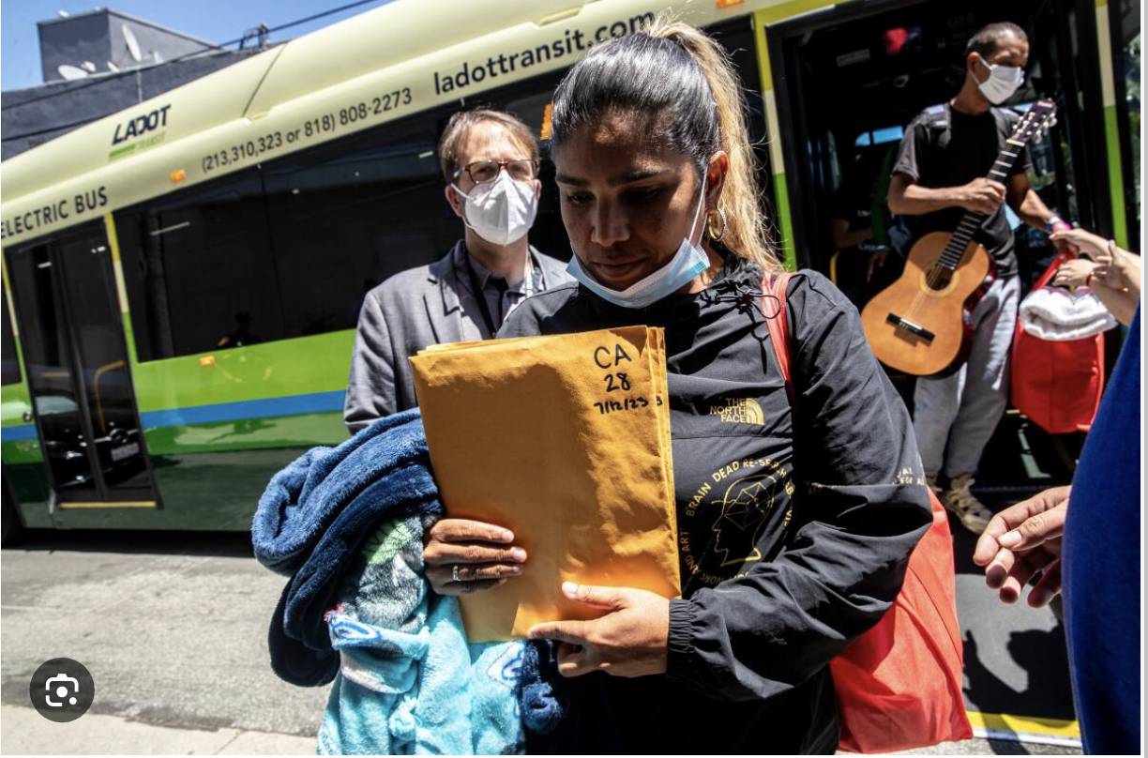
The Bussing of Migrants

Slide 43
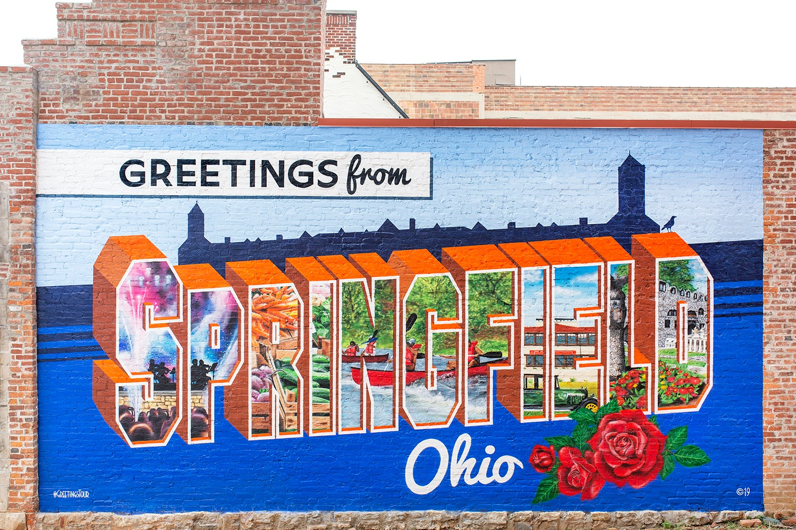
What Happened in Springfield, Ohio?

Slide 44
Temporary Protected Status (TPS)
The Secretary of Homeland Security can grant
Can be granted to foreign-born persons who can’t return to home country safely due to their country unable to handle their return
Acceptable reasons
  Conflict - epidemic
  Hurricane or earthquake - Other temporary conditions
Temporary status but can be extended
Can work and travel within the United States
May be eligible for welfare such as TANF, SNAP, Medicaid

Slide 45
Executive Orders by President Trump (2025)
Declared National Emergency at the Border
Suspended Temporary Protected Status for Some Venezuelans – Court Order Put IT on Hold
Ended “Catch and Release”
Third Country Asylum (El Salvador)
Expedited Removal.
Troops at the Border
Build Barriers

Slide 46
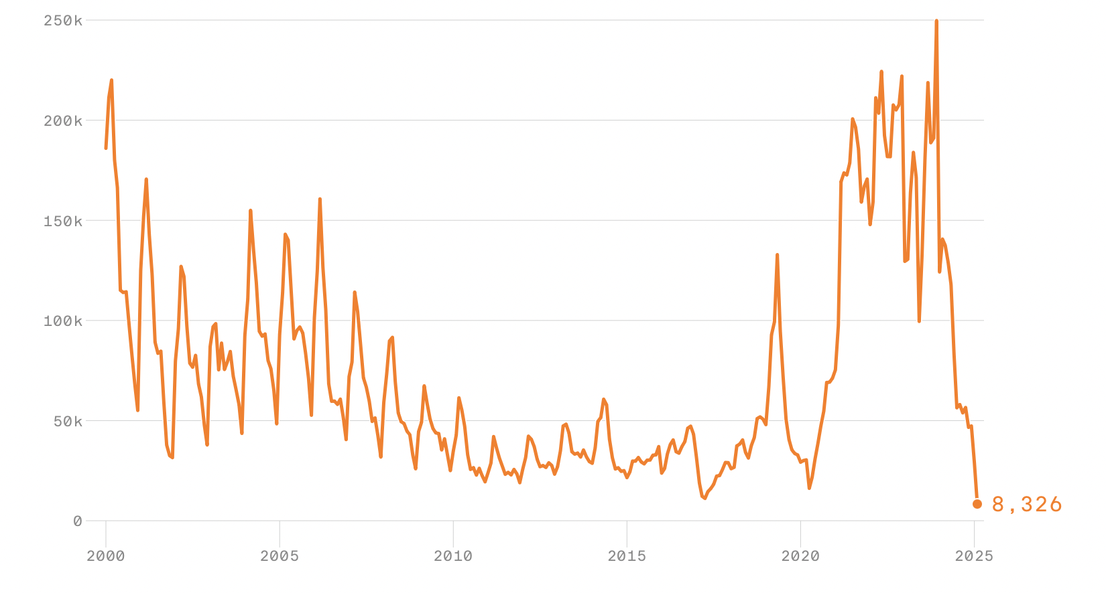
Monthly Border Patrol Apprehensions
2000
2005

Slide 47
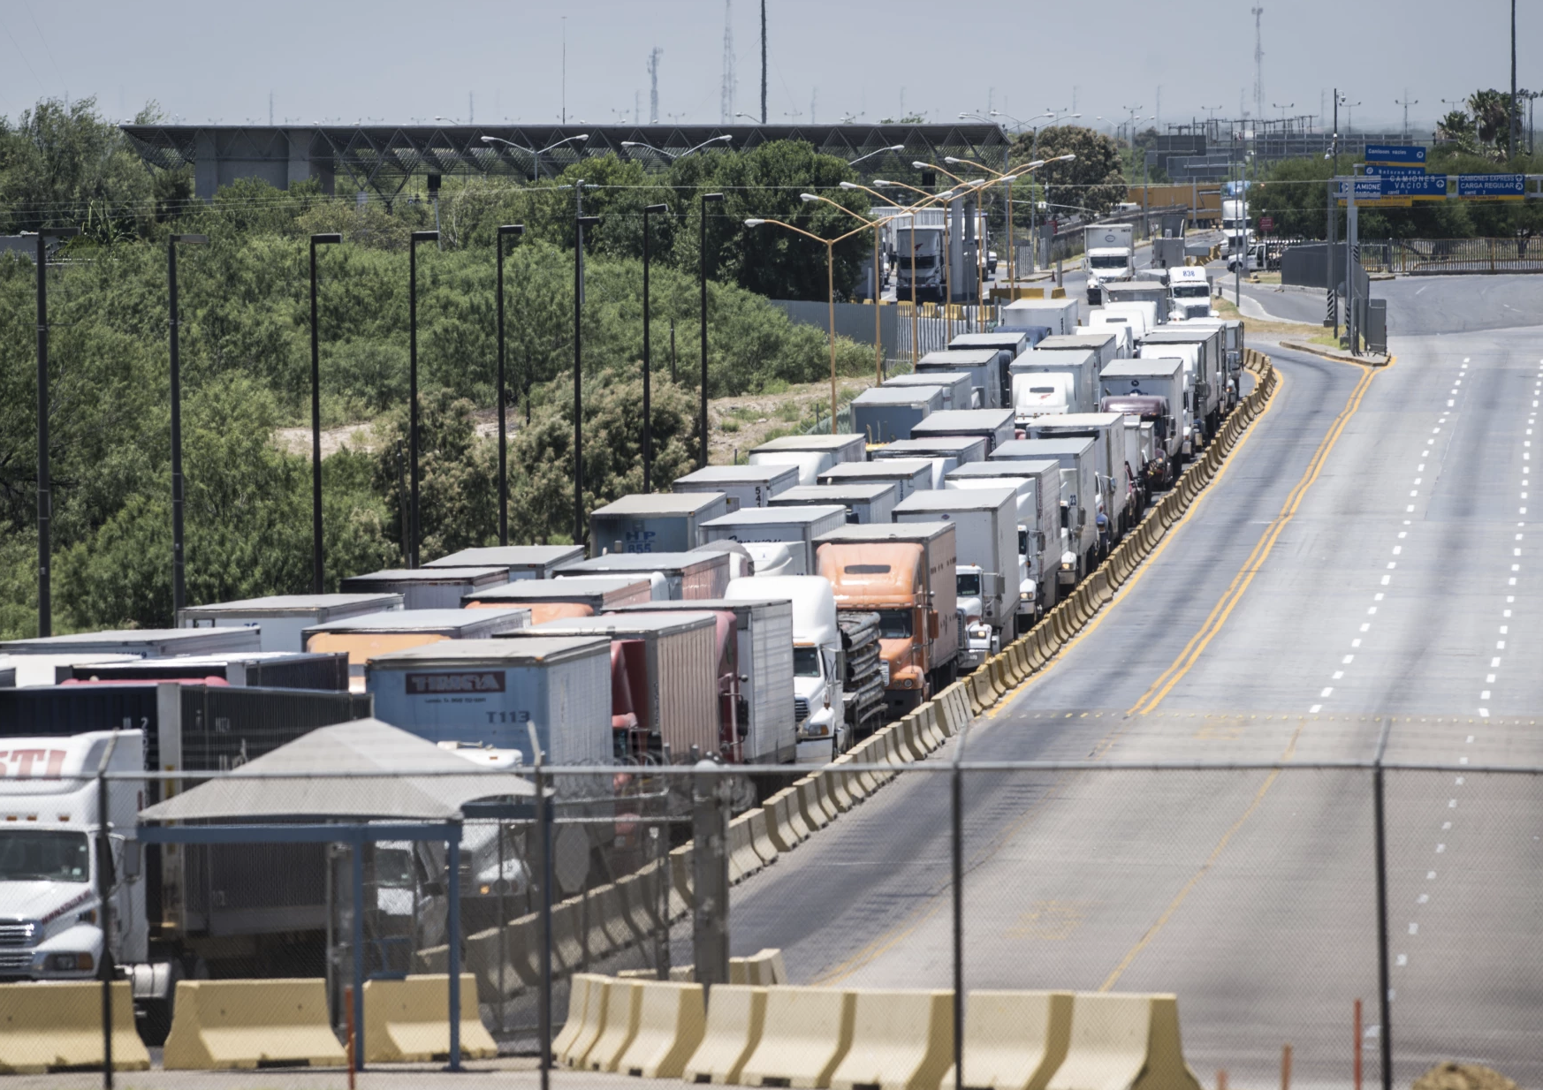
Final Thoughts
Building a wall might not be effective
Going through the dessert is dangerous
Illegal to hire undocumented workers but still done
Undocumented are not eligible for welfare
Maybe a points system like Canada

Slide 48
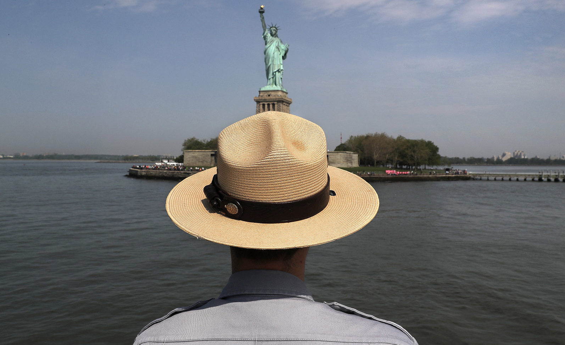
Thank you!
Questions?
Robert Gitter
rjgitter@owu.edu
Contact NEED: info@NEEDEcon.org
Submit a testimonial: www.NEEDEcon.org/testimonials.php
Become a Friend of NEED: www.NEEDEcon.org/friend.php

